Slide 2
Engaging young African women by appealing to their DREAMS
Nina Hasen, PhD
Population Services International
@NinaHasen
Share your thoughts on this presentation with #IAS2019

Slide 3
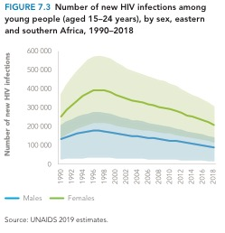
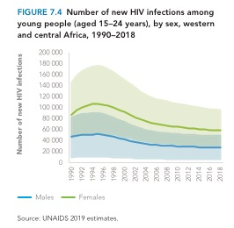
Our HIV prevention programs haven’t changed health outcomes for AGYW – why is that?
Notes:
We start with OUR goals – prevent pregnancy, prevent HIV, stay in school
Then we attempt to make our goals and activities – getting your partner to wear a condom, going to school, getting tested – attractive to them
This can sometimes lead to positive reviews from teens (e.g. for AFSRH) but not to shifts in health outcomes. We can get them to like us, but not to commit to the health goal

Slide 4
We haven’t understood teen biology, psychology & sociology
Gardner et al, 2005
Mills et al, 2014
Notes:
Adolescent brains are different: more risk-seeking, impulsive in the presence of peers, less developed self-control and planning.
Focusing on what makes services appealing to teens doesn’t get at deeper issues around relationships with parents, partners and the community
We’re not creating a central motivation for teens to engage in healthcare. A service can be attractive, but if she’s not actively motivated to use it, she won’t go more than once.

Slide 5
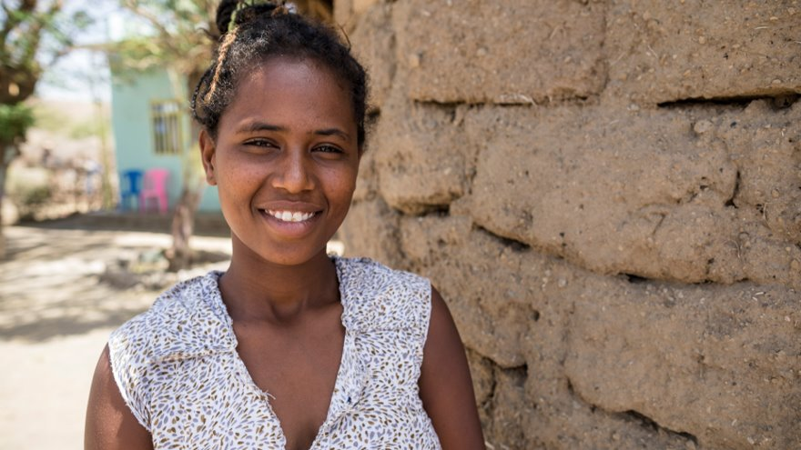
Reimagining contraceptive services ​with girls, for girls to unlock hope ​& rapid contraceptive uptake.
Notes:
PSI has been attacking this problem from the contraception side with encouraging results
Today I’m going to show you results from the Adolescents 360 project, funded jointly by the Bill & Melinda Gates Foundation and the Children’s Investment Fund Foundation
This project used a multi-disciplinary, human-centered design approach to answer the question: how do we drive uptake of contraception by adolescent girls at scale?

Slide 6
For teens, motherhood is a common goal that must be protected, and economic security is key
Public Health & AYSRH
Meaningful Youth Engagement
Human Centered Design
Adolescent Developmental Science
Cultural Anthropology
Social Marketing
Six dominant themes across all countries
Anxiety and uncertainty about how to secure a stable future
Misalignment between sexual behavior, contraceptive use and identity
Motherhood as the achievable dream
Contraception as a threat to the dream of motherhood
Isolation and mistrust
Girls’ complex connections to their mothers
Notes:
Key insighst: having children is a primary goal for all teens. Anything that threatens fertility is feared and avoided. Many girls believe myths that contraception causes infertility. Paradoxically, the key to getting girls to contracept is reassuring them that they can and will be mothers when they are ready and that contraception protects their ability to do so. The focus is not on pregnancy prevention, but fertility protection.

Slide 7
Smart Start increases uptake of contraception via financial planning
January 2018 - May 2019
624
Sites activated
21,450
76%
22%
Host Smart Start programming.
Adopters of
modern contraception.
% who adopt modern contraception
after A360 contact
% who choose a LARC
Notes:
In Ethiopia, our target segment is rural married teens. For these couples, having children is a treasured goal and knowledge of contraceptive options is slim. Furthermore, girls’ ability to choose and use contraception on their own is limited – husbands are powerful and girls prefer to make the choice with them. For these couples, attaining economic security in the form of owning a good house, having sufficient land and animals and access to food are high priorities. A360 researchers, including teen researchers, designed this intervention with girls to focus on financial literacy and planning. The tool was then adapted for use by busy HEWs, who can deliver a brief intervention that identifies a couple’s goals and helps them see the crucial role birth spacing and planning plays in achieving those goals. These values also align with a GoE goals around economic stewardship and reducing teen pregnancy. They also resonate with these young couples: 76% of couples who receive the Smart Start intervention choose to begin contracepting, and 22% of those choose a LARC. Smart Start is rapidly transitioning this program to the GOE with support from CIFF.

Slide 8
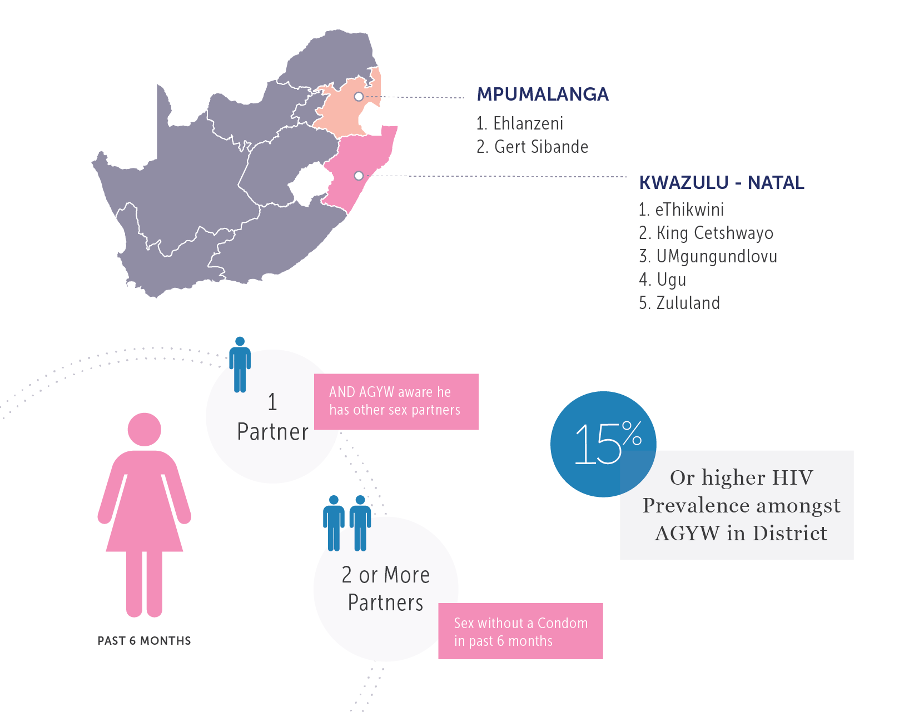
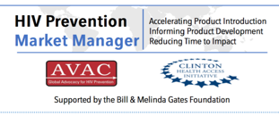
Breaking the Cycle: Understanding HIV prevention from a teen’s perspective
High-risk inclusion criteria
AGYW (N=1987)
AG (Adolescent Girls) Ages 15-19 years
YW (Young Women) Ages 20-24 years

Slide 9
3 Core Insights, 3 Segments
Insights
Segments
For most AGYW, a healthy emotional relationship is the primary goal.
HIV prevention is not an explicit goal or priority.
HIV prevention strategies must align with relationship goals in order to have relevance.
Lifestyle Seeker (27%): Seeking alignment with her lifestyle needs
Affirmation Seeker (37%): Seeking affection, desirability and safety
Respect Seeker (36%): Seeking respect and equality

Slide 10
The teen journey to becoming a health protector
1 SHAPING
2 REALITY CHECK
3 RE-EVALUATING
4 EMBEDDING
5 EVOLVING
OPINION
FORMED
NEW RESOLUTIONS
THE BIG FLIP
LIFESTYLE ALIGNED
CONTINUALLY VOLVING
Opinion Formed
New Resolution
‘The Big Flip’:
Internal Reorientation
Lifestyle Aligned
Healthy
Sexual Relationships
If someone cares about me, they should show me (with gifts)
I need to make sure men are going to provide for me
I don’t need to risk my health to live the lifestyle I desire
My relationships are aligned to a successful lifestyle
Relationships aligned to lifestyle goals
I should be with partners that make me feel desirable
One partner is not satisfying my emotional needs
Relationships can fulfill my emotional needs without compromising health
I am emotionally fulfilled in my relationships
Relationships that provide sustained affection
I can keep myself safe by making good partner choices
I need to wait until I find men that are trustworthy
I am able to take more control in protecting my health
Sexual health is a shared relationship goal
Mutually respectful relationships

Slide 11
How might we create experiences that help girls “flip”?
Lifestyle Seeker (27%): HIV prevention aligns with her lifestyle
Affirmation Seeker (37%): HIV prevention to make relationships safer and more affirming
Respect Seeker (36%): HIV prevention as a form of independence and control
60% of high risk women are in stages BEFORE the flip.
40% of high risk women are still in an UNSTABLE habit
Number of of AGYW
BEFORE THE FLIP {STAGES 1, 2 & 3)
AFTER THE FLIP {STAGES 4 & 5)
a) Based on claimed responses (not behavioral),
b) Weighted data after excluding Women 18 or older in Stage 0
11

Slide 12
Conclusions:
Success depends on starting with what teens value – understanding that and taking it seriously
Designing with teens is key – we think we “get it” and we’re wrong
Designing with HCWs is also key – it must be feasible to scale
Adaptive implementation is a model for getting interventions from promising to great

Slide 13
Thank you!
Nina Hasen
nhasen@psi.org
www.psi.org
www.psiimpact.org

